Slide 1

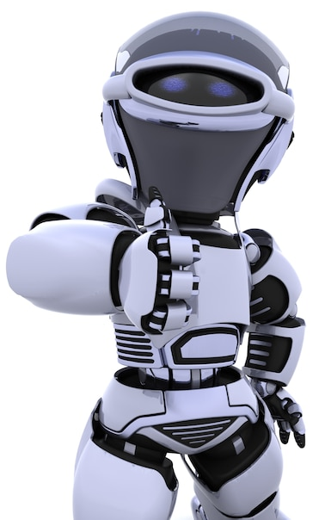
Artificial Intelligence – 30 Days Challenge - தமிழ்
Face recognition & its application | Overview on Recognizer | Creating dataset & Face recognition
DAY 7 / 30

Slide 2
Prerequisites for this Course
Laptop with Good Internet
No basic knowledge is required.
Note & Pen

Slide 3
Face recognition
Face recognition is a method of identifying or verifying the identity of an individual using their face. Face recognition systems can be used to identify people in photos, video, or in real-time.
1.Preventing crime
2.Unlock device
3.Blind assistance
4.Attendance system
5.Payments

Slide 4
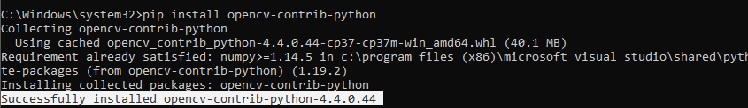
Installing Libraries
OpenCV-Contrib : pip install opencv-contrib-python

Slide 5
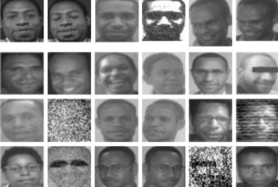
Fisherface Recognizer
Fisherfaces algorithm extracts principle components that separates one individual from another. So , now an individual's features can't dominate another person's features.
Fisherface method will be applied to generate feature vector of facial image data used by system and then to match vector of traits of training image with vector characteristic of test image using euclidean distance formula

Slide 6
Block Diagram – Workflow of Face Recognition
Loading face detection algorithm
Loading Classifier for face recognition
Training classifier for our dataset
Reading frame from camera & pre-processing
Face detection by its algorithm
Predicting Face by loading frame into model
Displays recognized class with its accuracy
Finding centre of contour Area
Drawing circle & centre

Slide 7
Ready For Hands On

Slide 8




THANK YOU☺
NOVITECH COIMBATORE
novitechresearchanddevelopment

